Slide 1
Project Frontiers Sprint 1 By: Shrimp Council

Slide 2

Team organization

Slide 3
Roles of the team +responsibilities
Team lead and product owner: Ingmar van Busschbach
Scrum master: Evelien de Wals

Slide 4
Designers
Lead Designer: Jay Ahne
Responsibilities:
Jay: level and narrative design
Selkie: gameplay, sound and narrative design

Slide 5
Engineers
Lead Engineer: Ingmar van Busschbach
Responsibilities:
Ingmar: source control, and technical and gameplay systems
Evelien: gameplay, technical and AI systems

Slide 6
Artists
Lead Artist: Branimir Nikolov
Responsibilities:
Branimir: environmental art
Eden: character art
Dennis: weapon and environment art

Slide 7
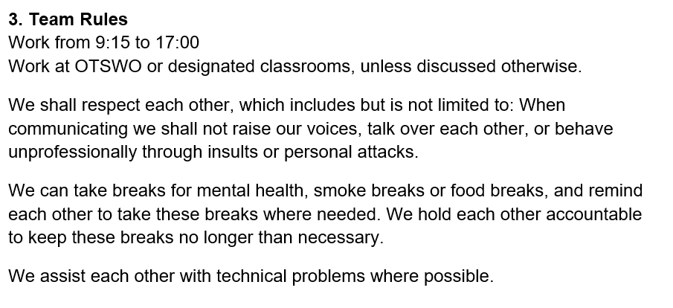
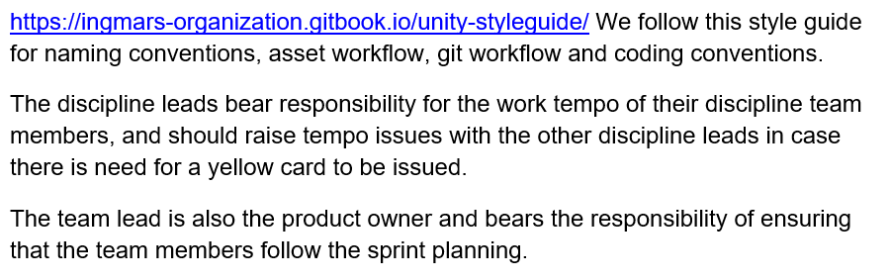
Team rules

Slide 8
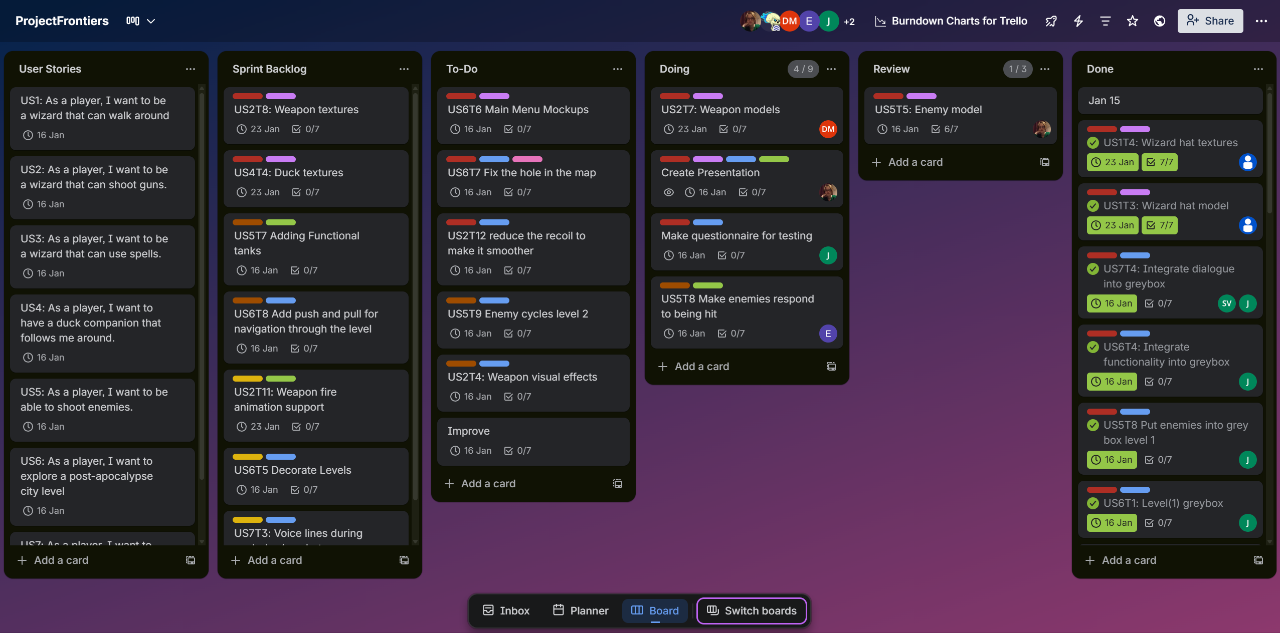
Trello Board

Slide 9
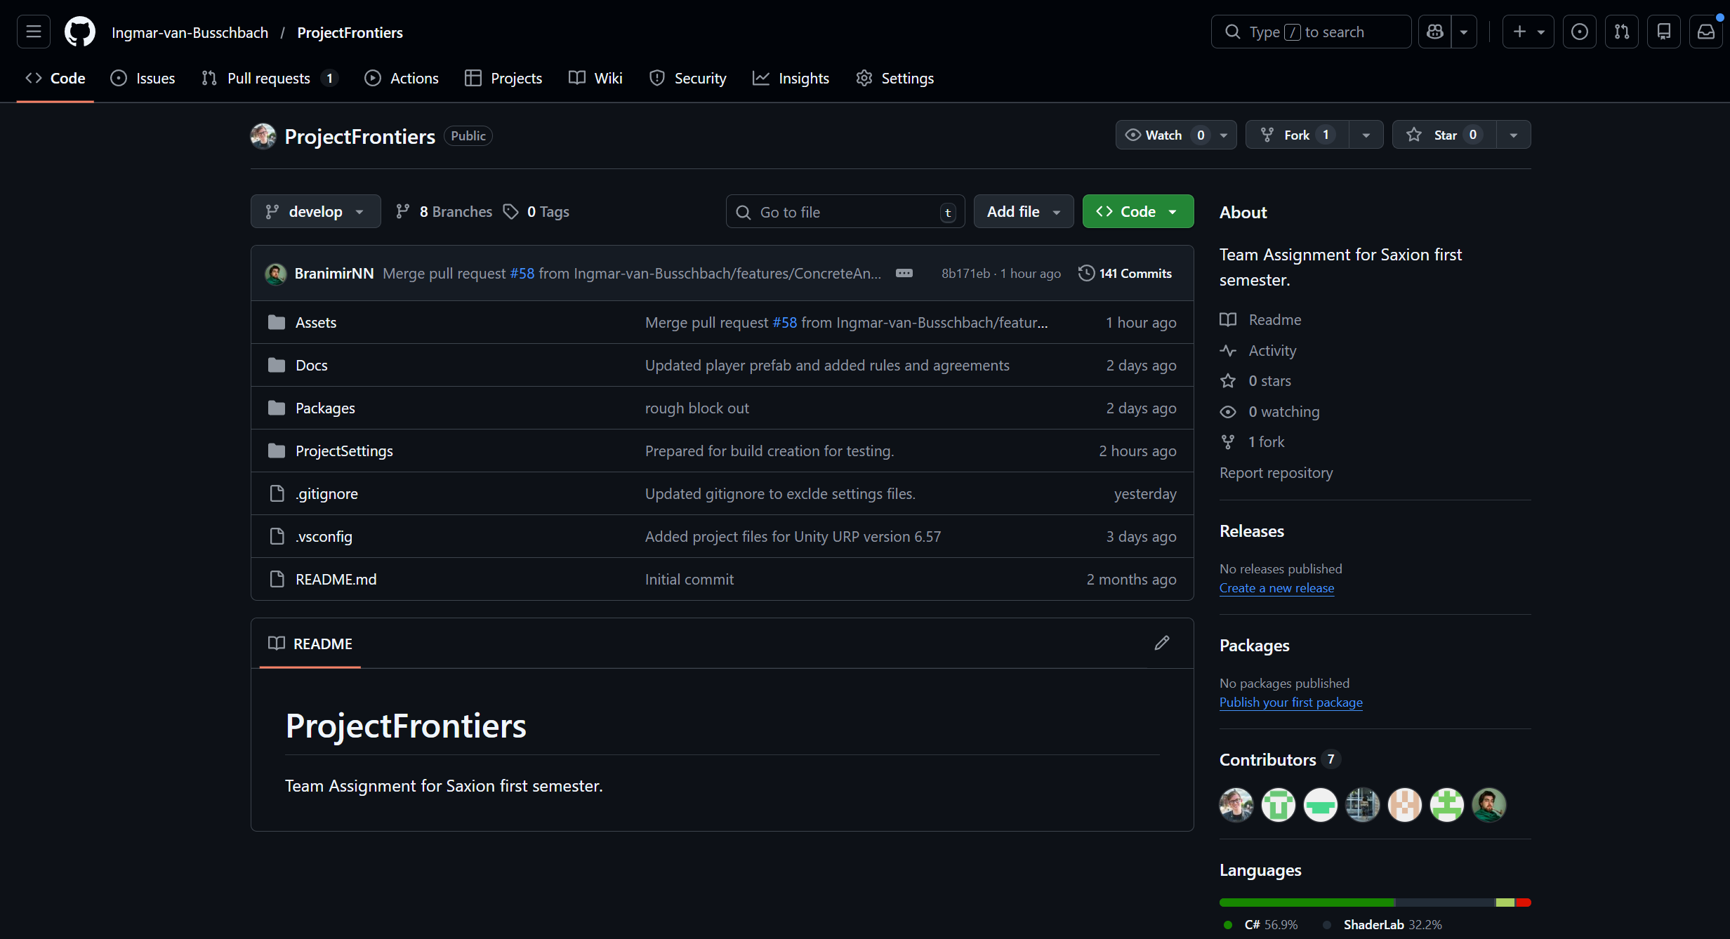
Github

Slide 10

Designers’ work
(insert short summary of finished things)

Slide 11
(Name)
(text)
(include pictures. E.g. scripts, wireframes, project screenshots, etc.)

Slide 12
(Name)
(text)
(include pictures. E.g. scripts, wireframes, project screenshots, etc.)

Slide 13
Engineers’ work
(insert short summary of finished things)

Slide 14
(Name)
(text)
(include pictures. E.g. scripts, wireframes, project screenshots, etc.)

Slide 15
(Name)
(text)
(include pictures. E.g. scripts, wireframes, project screenshots, etc.)

Slide 16
Artists’ work
Blockouts, some final models and texturing

Slide 17
(Name)
(text)
(include pictures. E.g. scripts, wireframes, project screenshots, etc.)

Slide 18
(Name)
(text)
(include pictures. E.g. scripts, wireframes, project screenshots, etc.)

Slide 19
(Name)
(text)
(include pictures. E.g. scripts, wireframes, project screenshots, etc.)

Slide 20
Planning for sprint 2

Slide 21
(title)
(To do’s)
(extra text if needed)

Slide 22
Rubric

Slide 23
(Rubric)
(To do’s)
(extra text if needed)

Slide 24
Thank you

